Slide 1

Logical Increments
RealEye Eye Tracking Test Results
Yisela Alvarez Trentini
13.07.2018

Slide 2
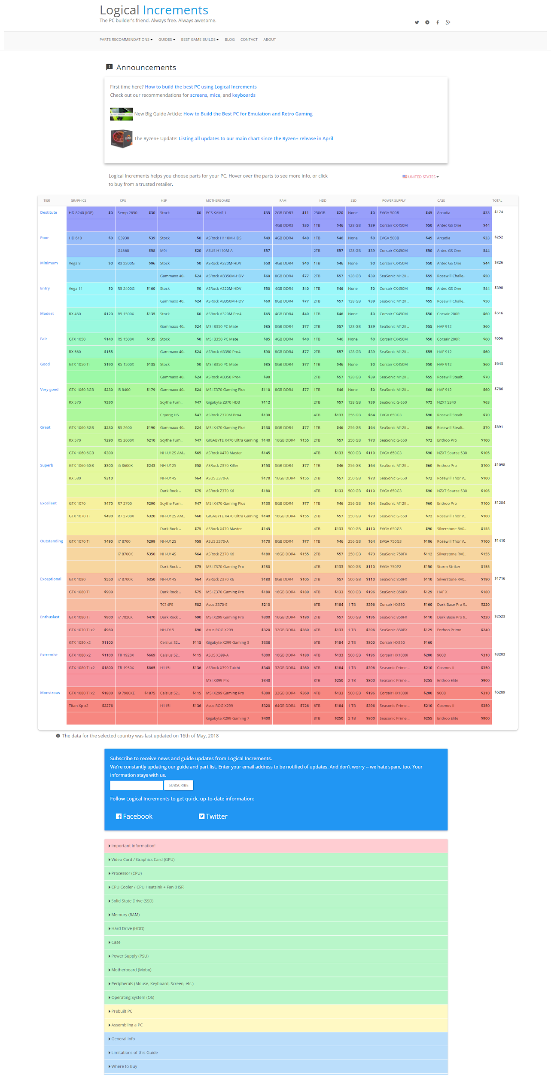
The Logical Increments Home

Slide 3
Test Specifications
Users 20 Paid Testers
Test Settings Stimuli time: 40000 [ms] Relax time: 1500 [ms] Fix point time: 1500 [ms]
https://www.realeye.io/test/14eefefe-a337-4dd0-8e0c-efbb8ea17ca8/

Slide 4
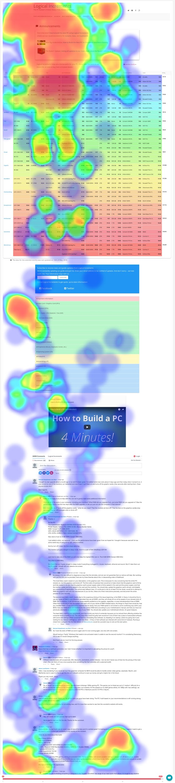
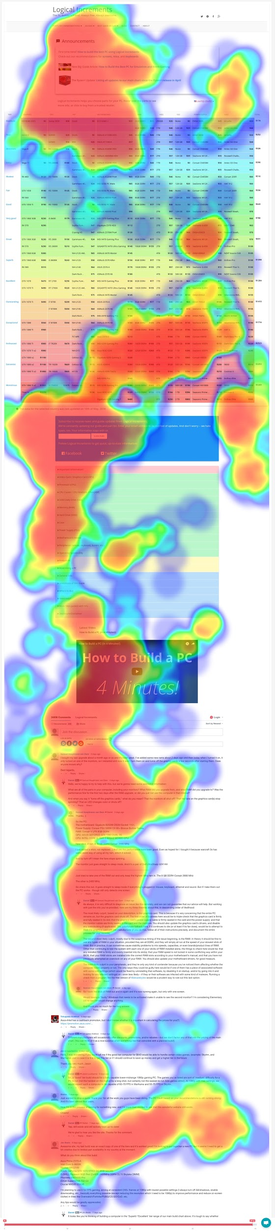
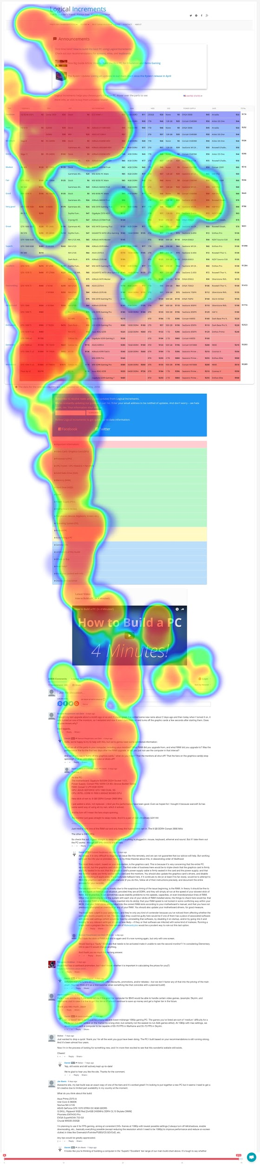
Findings
Consistent with general eye tracking findings, the direction of scanning is vertical and stronger towards the left side. An “F” pattern scans the right side as well.

Slide 5
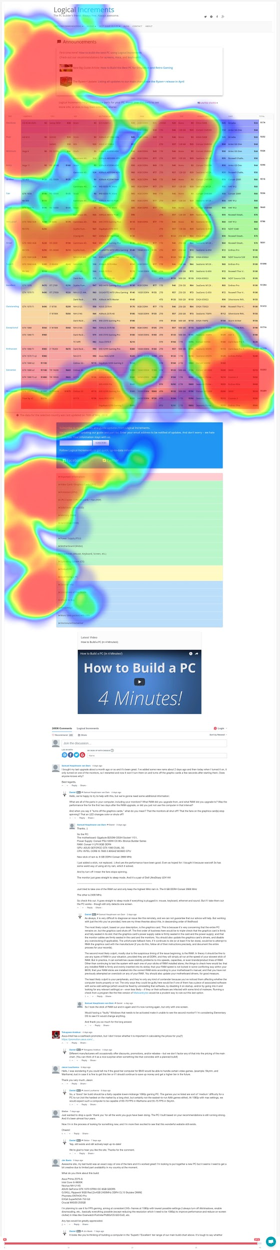
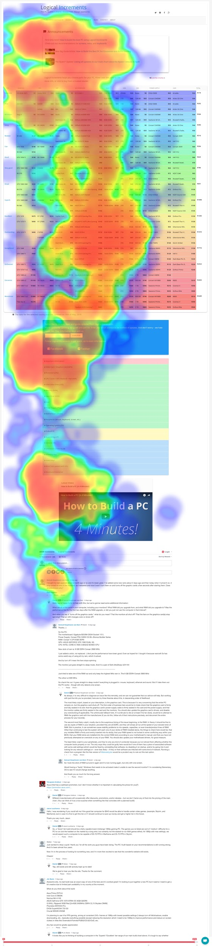
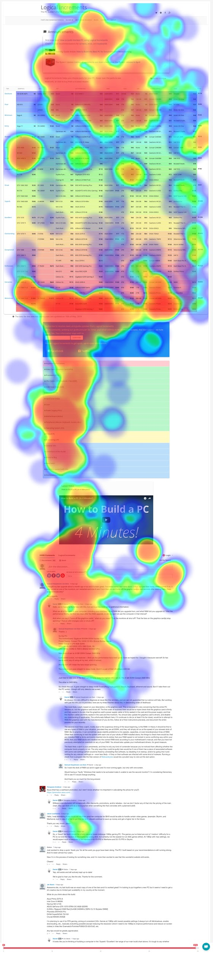
Findings
As expected, most people spend a larger amount of time understanding and exploring the area above the fold. The attention seems focused on the notification boxes, rather than the menu or social links area:

Slide 6
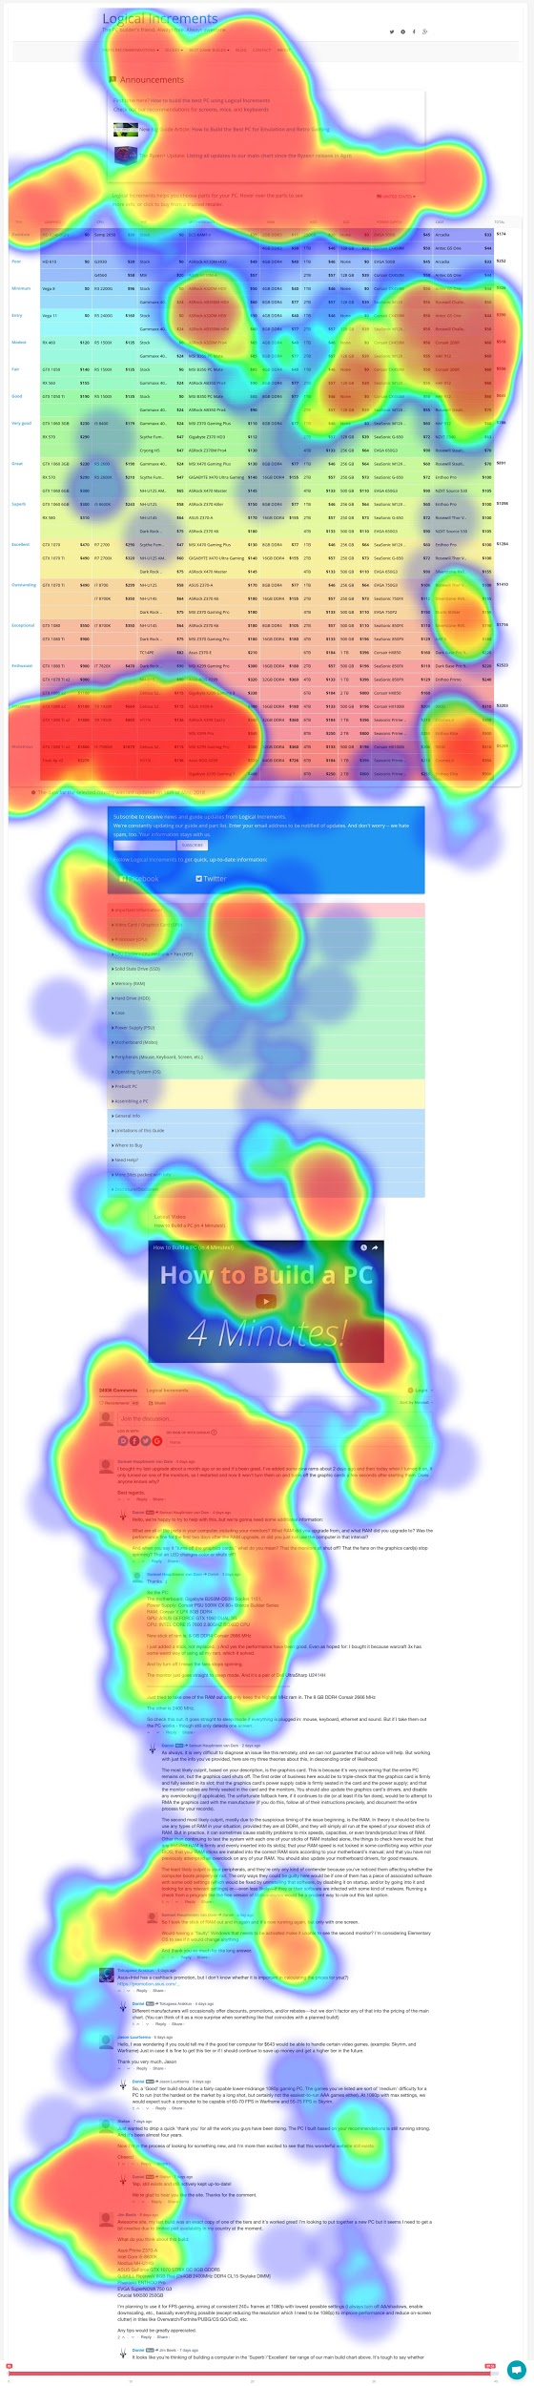
Findings
The table seems to be uniformly scanned, although this might be explained by the users not being the expected audience. Although most users keep scanning vertically and more focused on the left, the Price Column seems to attract some attention.

Slide 7
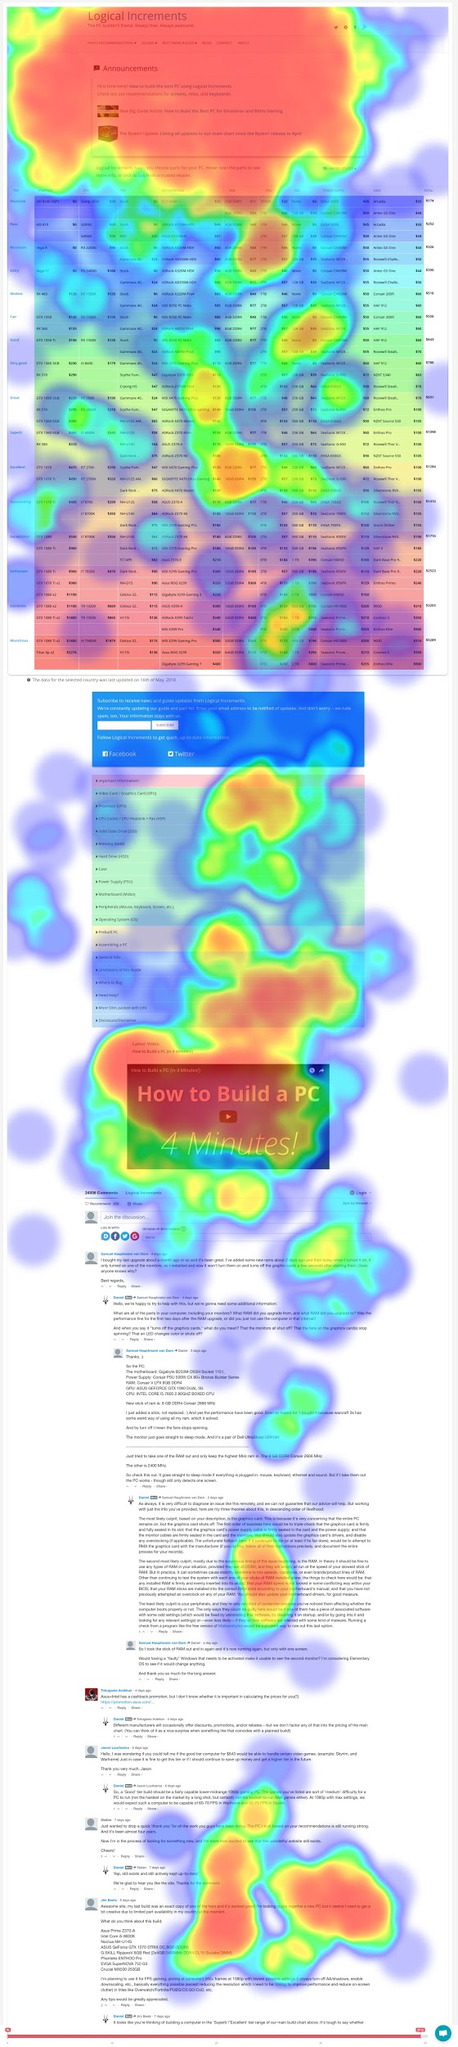
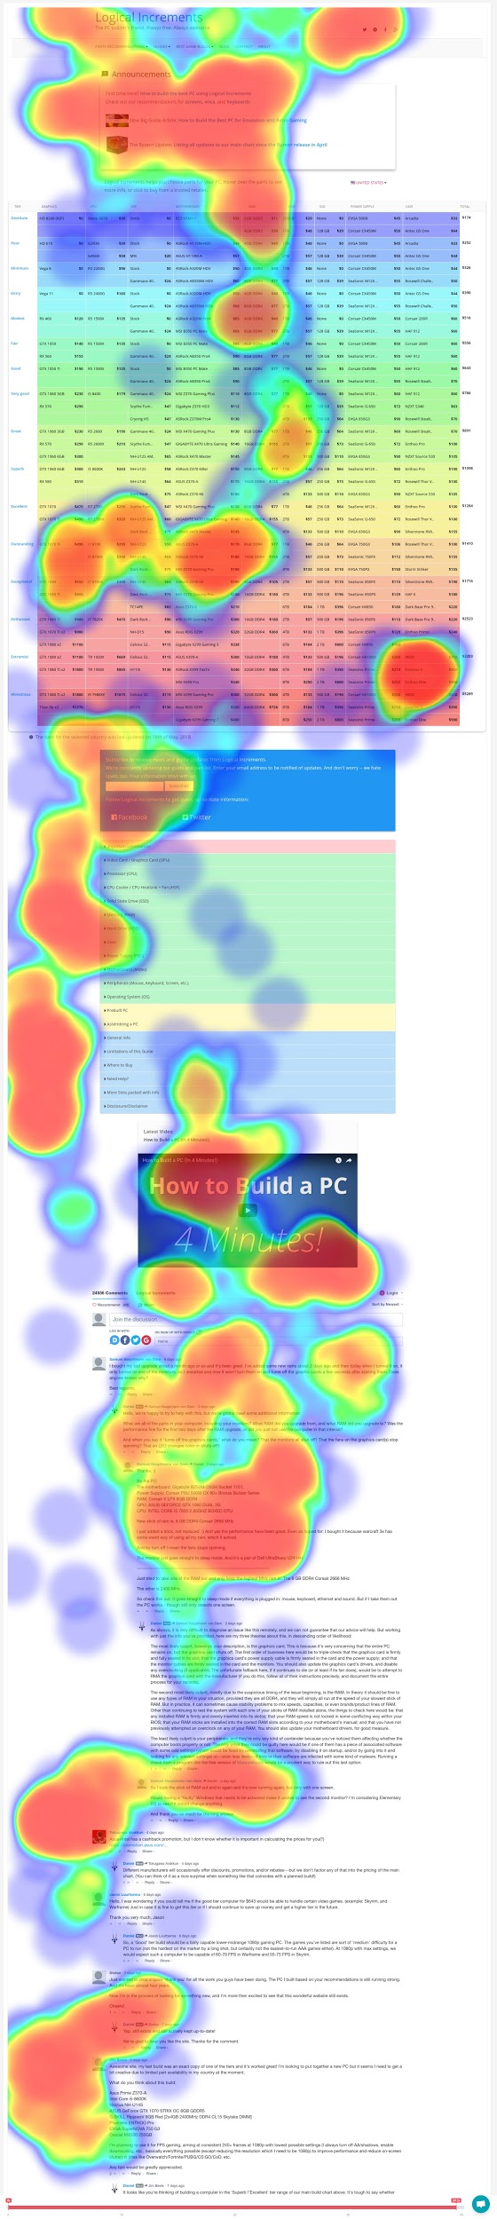
Findings
For users that scroll down, the Video seems to act as a good anchor, and generally gets a significant amount of attention:
Users’ attention decreases as they scroll down, but it picks up again towards the end of the page.
The video is probably being interpreted an important element that marks the end of a section - although it seems that users then realize there are comments, and become interested in them.

Slide 8
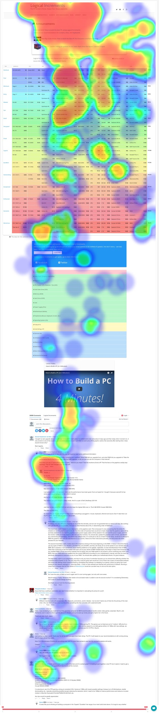
Findings
As the attention decreases scrolling down, the Comments Section seems to be working effectively at capturing the user’s interest. This probably also has to do with reading testimonies of real people - it’s easier for the user to identify themselves with them:

Slide 9
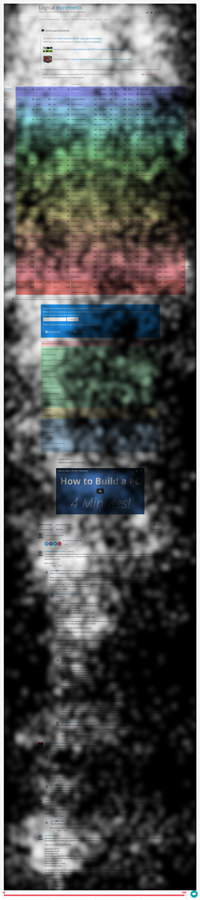
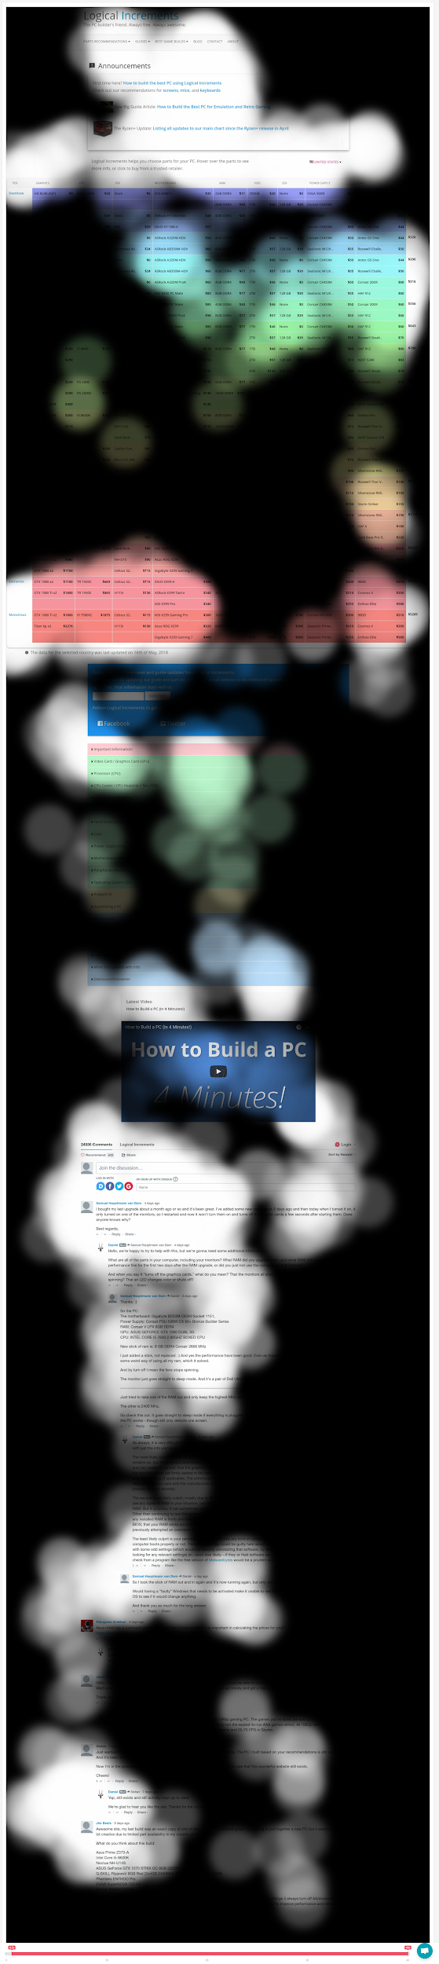
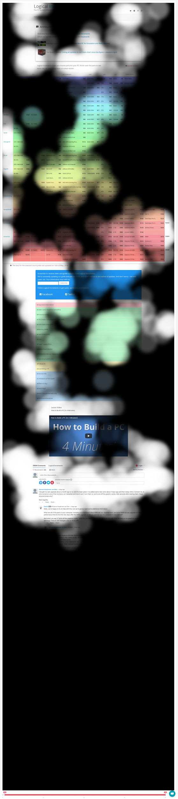
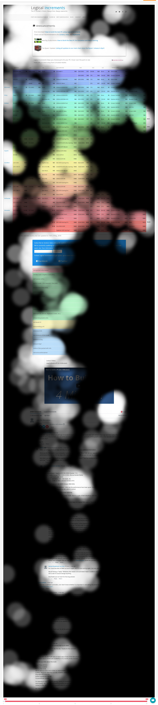
Findings
Some elements, as they are closer to the right edge, are completely invisible:

Slide 10
Conclusions
It’s noted that users:
Focus on the area above the fold more than any other area;
Don’t particularly notice the menu (and therefore have less chances of understanding the site structure);
Scan the content vertically, and lean towards the left side (right side is practically invisible);
See the table as a whole, and try to understand it by scanning horizontally as well as vertically;
Use the video as an anchor for scanning the page;
Are interested in the comments.

Slide 11
Thank You!

